Slide 1
Laws Influencing Information Security and Privacy in the Healthcare Sector Naraniya Mamatha Nagpuria University of The Cumberlands 2024 Fall - Legal Reg, Compliance, Invest (ISOL-633-M50) - Full Term Dr. Roger Finnegan October 27, 2024

Slide 2
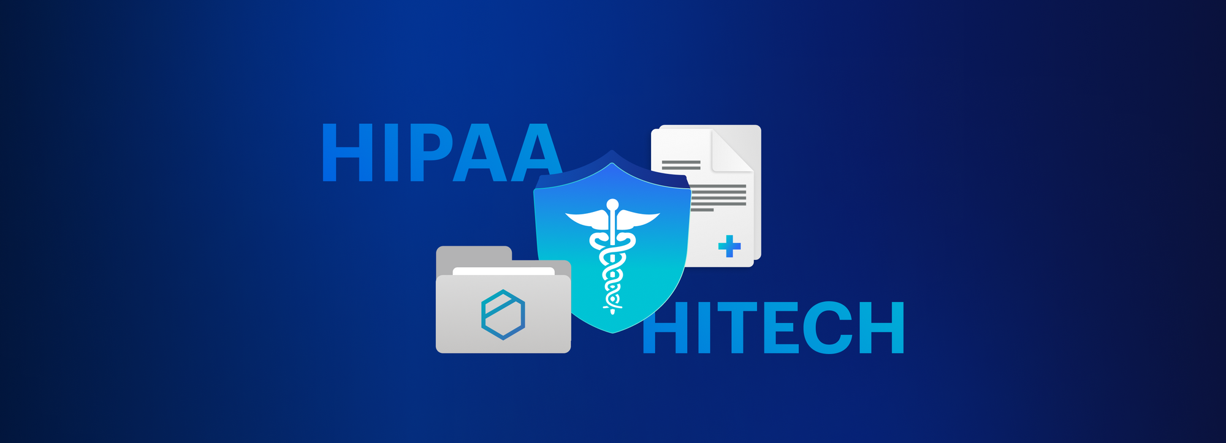
Introduction to Healthcare Information Security
Key Point: Digitalization in healthcare has raised critical needs with regard to the regulation of the mode that health care organizations will treat patient data, sensitive medical information; hence, the establishment of very important laws like HIPAA and the HITECH Act.
Main Laws:
HIPAA (1996): Introduced to protect the privacy and security of patient data through rules on the Privacy Rule that dictates the use and disclosure of Protected Health Information (PHI) and the Security Rule, which requires administrative, physical, and technical policies, procedures, and standards to prevent unauthorized access (Choi et al., 2006).
HITECH ACT (2009): This is the act that supplemented and expanded HIPAA by adding timely breach notifications and more stringent penalties for non-compliance—especially with the increase in the implementation of EHRs, or digital health records, and data exchange (Yaraghi & Gopal, 2018).
Notes:
Digitization in healthcare reaps many benefits; at the same time, it has grave concerns regarding patient data privacy and security. To handle such concerns, the various laws, including the HIPAA and the HITECH Act, set a bar to protect medical information, forcing organizations to adhere to stringent rules on management and sharing sensitive patient records.

Slide 3
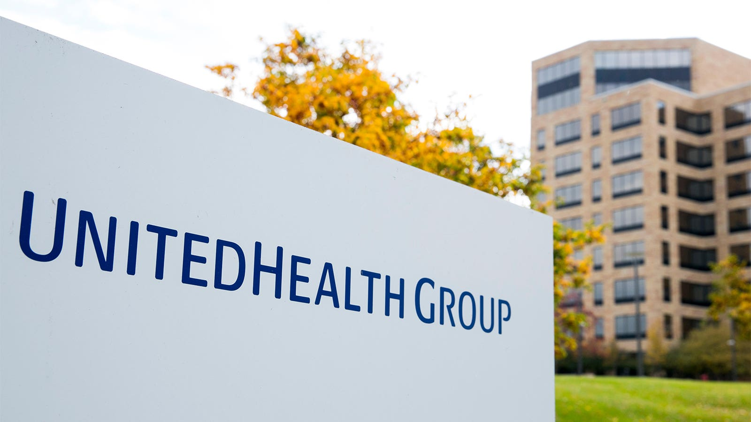
UnitedHealth Group Overview
Key Business Areas: The two main business segments that drive revenue for UnitedHealth Group include UnitedHealthcare, as the business segment focused on health insurance services, and Optum, which is healthcare technology and services, encompassing analytics, consulting, and virtual care (Mohammed et al., 2015).
Compliance Issues: UnitedHealth is supposed to guarantee comprehensive compliance to HIPAA and the HITECH Act through a broad network of healthcare services and different types of partnerships with third-party providers by way of regular monitoring, assessment of risks, and system audits, so that unauthorized access to information is at a minimum and the trust of patients and other stakeholders is maintained (Mbonihankuye et al., 2019).
Notes:
UnitedHealthcare Group leads in handling much patients' data throughout its insurance and technology platforms. Due to the complexity of its operational structure, the organization must be in full observance with all the federal laws regarding privacy; this calls for enduring audit processes and continuous investment in cybersecurity so that the patient information shall not be disclosed.

Slide 4

Risks and Challenges
Criminal Risks: The organizations in the health sector, including UnitedHealth, are increasingly becoming a target for cybercrimes through advanced ransomware and phishing attacks with the motive of stealing patient data. Besides attracting severe monetary fines, this also amounts to a breach of patient trust. The fine for HIPAA non-compliance may reach $1.5 million for covered entities in cases of single incidents. Also, in the worst-case scenario of willful neglect, criminal liabilities like imprisonment may be imposed (VanHoy, 2021).
Tort risks: Besides the regulatory sanctions, this entity, UnitedHealth, is equally liable under tort claims where the patients are suing for damages because of negligence or mishandling of personal information and may be litigated with considerable financial settlements along with reputational loss and invite enhanced scrutiny from the public and regulators (Choi & Williams, 2021).
Notes:
Despite all attempts, including those made by organizations like UnitedHealth, the sector is still significantly vulnerable to cyberattacks that can bring devastating financial and legal repercussions. Ransomware attacks and data breaches also bring heavy fines and even imprisonment of the culprit but also allow lawsuits from affected patients, and it is therefore important for organizations to exercise cybersecurity practices.

Slide 5

Case Study – UnitedHealth Data Breach
Incident (2024): UnitedHealth Group reported a ransomware attack on its technology subsidiary Change Healthcare, which has resulted in the exposure of personal data belonging to nearly 100 million people, topping an earlier breach, the 2015 Anthem incident, which affected 79 million people (iTnews, 2024).
Impact: The ransomware attack rendered claims processing systems dead, disrupted healthcare services across the country, and is expected to create financial losses amounting to roughly $705 million. Other costs to be incurred would be related to compliance measures, forensic investigations, and various breach notifications. UnitedHealth took steps to implement sophisticated security protocols, such as encryption technologies, to help prevent further breaches and restore the public's confidence in the institution (Mishra & Siddiqui, 2024).
Notes:
The UnitedHealth data breach in recent times is a tablet of realities showing vulnerabilities even in some of the most mentally progressed healthcare organizations. The incident brought forward losses in huge amounts and also forced the firm to reconsider its cybersecurity strategy and be proactive against further attacks.

Slide 6
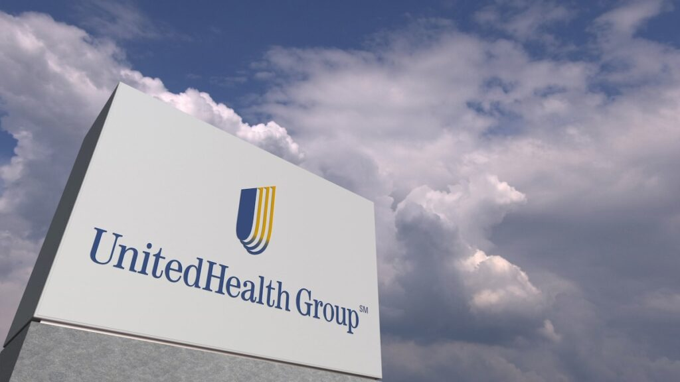
Balancing Compliance and Innovation
Opportunities: UnitedHealth increases its competitive advantage and, in turn, the better care for its patients with the intellectual property portfolio in the region of advanced analytics in healthcare, artificial intelligence solutions, and telemedicine technologies (Goldenberg & Grantcharov, 2018).
Challenges: In maintaining compliance with HIPAA and other regulations, the pace at which new technologies are adopted could be slow within facilities. This is because an organization has to create a proper balance between the need for innovation and the legal duty toward patient privacy and security of data. Such balancing would be required to ensure that there is regulatory compliance and operational efficiency (Yaraghi & Gopal, 2018).
Notes:
With UnitedHealth making unprecedented investments in the areas of health technology and innovation, meeting compliance needs related to the use of the privacy act, on the other hand, presents trouble in terms of adopting new solutions. A lasting success within a competitive and highly regulated industry will depend on how well the organization lays out an operational efficiency strategy that will integrate innovation with demands for legal compliance.

Slide 7
References
Choi, Y. B., & Williams, C. E. (2021). A HIPAA Security and Privacy Compliance Audit and Risk Assessment Mitigation Approach. International Journal of Cyber Research and Education, 3(2), 28–45. https://doi.org/10.4018/ijcre.2021070103
Choi, Y. B., Capitan, K. E., Krause, J. S., & Streeper, M. M. (2006). Challenges Associated with Privacy in Health Care Industry: Implementation of HIPAA and the Security Rules. Journal of Medical Systems, 30(1), 57–64. https://doi.org/10.1007/s10916-006-7405-0
Goldenberg, M., & Grantcharov, T. (2018). Enhancing Clinical Performance and Improving Patient Safety Using Digital Health., 235-248. https://doi.org/10.1007/978-3-319-61446-5_17
iTnews. (2024, October 25). Hack at UnitedHealth’s tech unit impacted 100 million people. ITnews. https://www.itnews.com.au/news/hack-at-unitedhealths-tech-unit-impacted-100-million-people-612616
Mbonihankuye, S., Nkunzimana, A., & Ndagijimana, A. (2019). Healthcare Data Security Technology: HIPAA Compliance. Wireless Communications and Mobile Computing, 2019(1), 1–7. https://doi.org/10.1155/2019/1927495
Mishra, M., & Siddiqui, Z. (2024, April 22). UnitedHealth says hackers possibly stole large number of Americans’ data. Reuters. https://www.reuters.com/technology/cybersecurity/unitedhealth-says-hack-could-impact-data-substantial-proportion-americans-2024-04-22/
Mohammed, D., Mariani, R., & Mohammed, S. (2015). Cybersecurity Challenges and Compliance Issues within the U.S. Healthcare Sector. International Journal of Business and Social Research, 5(2), 55–66. https://doi.org/10.18533/ijbsr.v5i2.714
VanHoy, J. (2021). Healthcare Sector Security Analysis. SSRN Electronic Journal. https://doi.org/10.2139/ssrn.3763392
YARAGHI, N., & GOPAL, R. D. (2018). The Role of HIPAA Omnibus Rules in Reducing the Frequency of Medical Data Breaches: Insights From an Empirical Study. The Milbank Quarterly, 96(1), 144–166. https://doi.org/10.1111/1468-0009.12314

